Slide 1
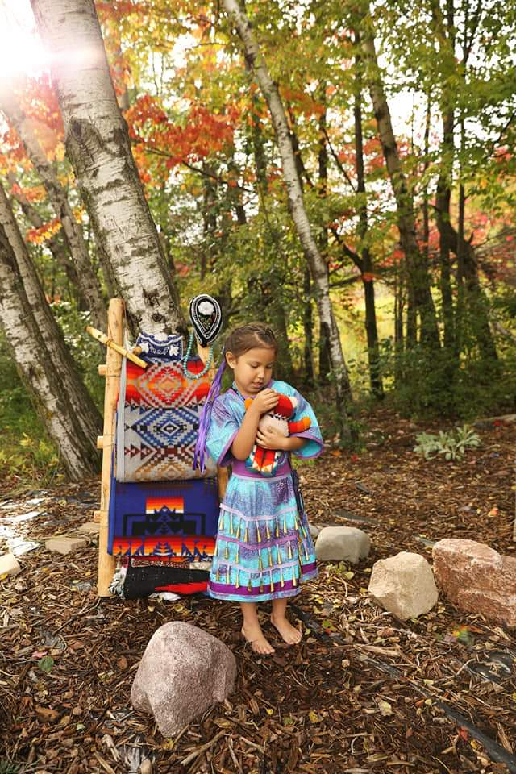


Slide 2
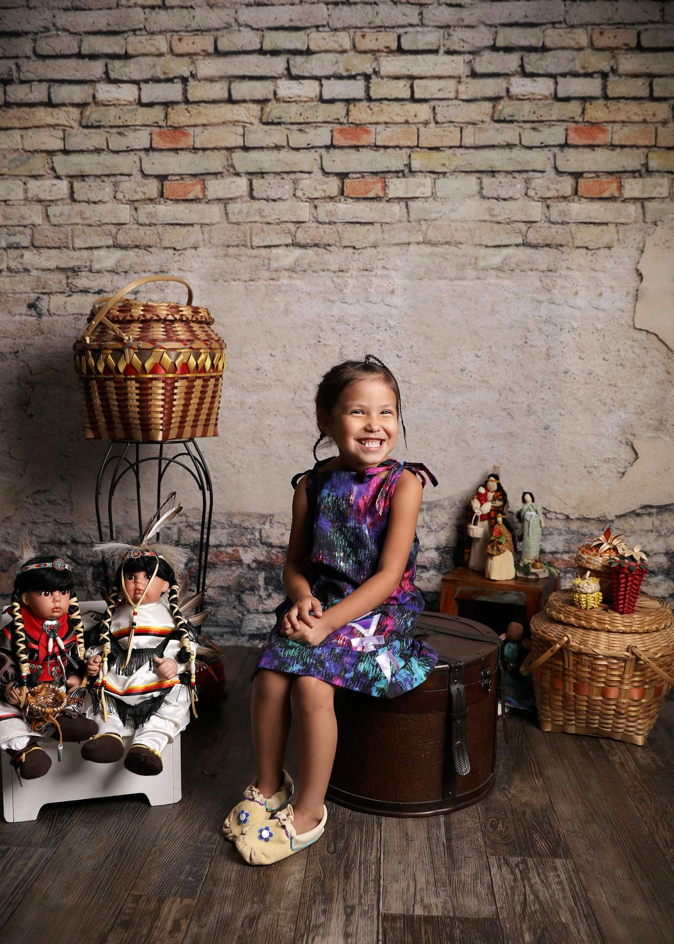
Native Higher Education Pathways

Slide 3
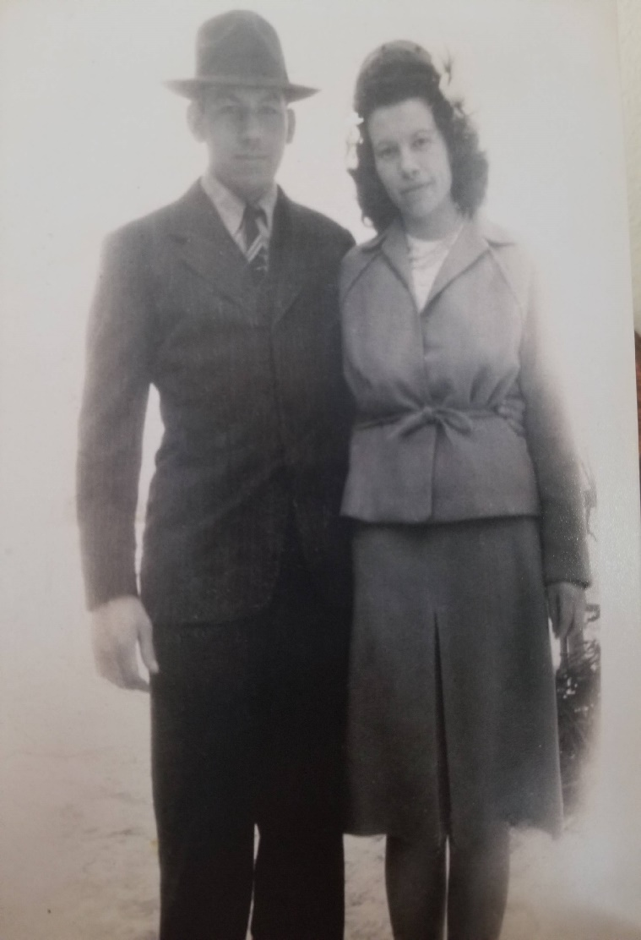
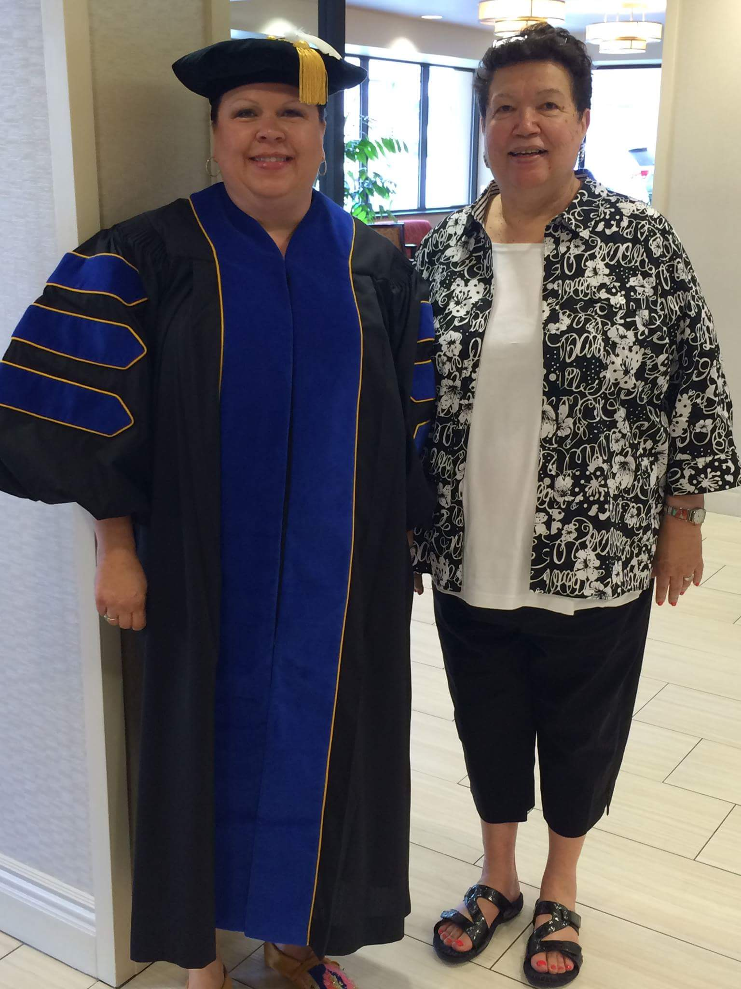


Clarence and Leona (Burr) Bowman
Jolene’s Maternal Grandparents
Jolene and Mom

Slide 4
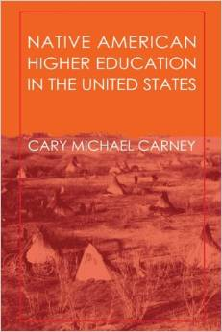
The Colonial Period
Reading
Carney, M. C. (1999). Native American higher education in the United States. New Brunswick, NJ: Transaction Publishers (pg. 30).

Slide 5
The Many Trail Symbol

Slide 6

Indigenous Students Building Tribal Nations through Persistence in Higher Education
TRIBALCRIT THEORY
Enters College
Not having/having
Indigenous knowledge
and culture throughout the institutional environment such as; policies, resources, college programs, campus/staff presence, student services, and student organizations.
Reasons for Stepping Out or In
Reasons for Stepping Out or In
Not having/having culturally responsive teaching and curriculum, academic skill building, higher expectations, and advanced placement courses throughout the high school years.
Institutional Support
College Readiness
Financial Aid
Indigenous Nations
(S/M Community)
Not having/having needs that are met, timely resources, and financial aid at the beginning of
a semester.
Not having/having
cognitive recognition for: the need to sustain and advance traditional language, culture, and history into academia; historical trauma from the boarding school experience; degrees not correlating to
status; and feelings of ambivalence among family, community, and nation.
Linear; Focus on Self
STRENGTHS
CHARACTERISTIC
Circular; Focus on the whole (historic)
Predominately White Colleges
Balance two
worlds within
Themselves
• Strong motivation,
engagement, and determination
• Resourceful
and Clever
• Strong support
network
Colonization
Tribal Identity
Tribal College
Degree Completion
Family/Social Influence
Life Imbalances
Not having/having
the understanding for: a strong innate desire and need to take care of children, elderly parents and/or grandparents before self; a tight and close connection to family and home which can lead to one being severely home sick when going away to attend college; and the personal value of attending and being part of traditional ceremonies and/or community happenings.
Not having/having
time management, budget/fiscal responsibility, commitment, and discipline skills, good health, and encouragement.

Slide 7
Implications for High School Practice
College Readiness
Higher expectations
Advance placement courses
Culturally Responsiveness
Classroom (Environment/Teaching Practices/Curricula)
Positive
Leadership
Respecting all backgrounds
Academic = Culture

Slide 8
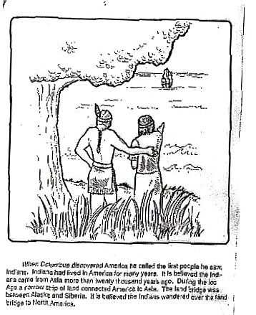
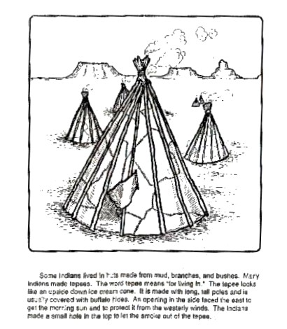
When Students Learn This . . .
This slide is copied from Leary, JP. (June 2010). Act 31 in 3-D!!! Considerations for Implementation and Evaluation power point presentation.
Notes:
]

Slide 9
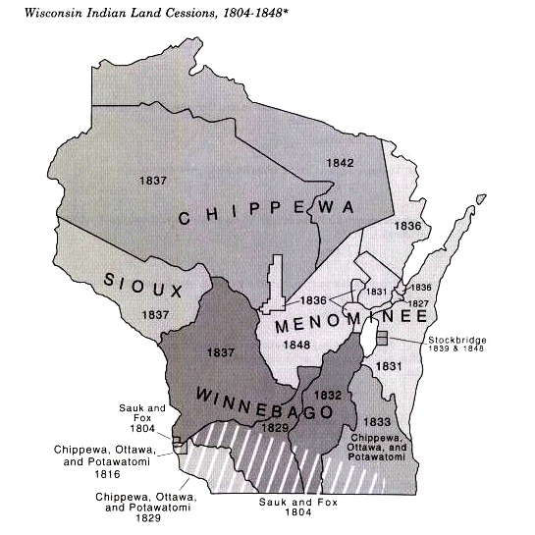
Teaching the Truth . . .
These land cession treaties reflect U.S. demand for:
Fertile Land (1829-1848)
Lead (1829)
Timber (1837)
Copper (1842)
This slide is copied from Zoltan Grossman, a geography professor at Evergreen State U. in Washington who was one of the founders of Midwest Treaty Network and it was used in Leary, JP. (June 2010). Act 31 in 3-D!!! Considerations for Implementation and Evaluation power point presentation..

Slide 10
Implications for College Practice
Family
Student Services
American Indian staff and faculty
Equal voice and/or vote
Provides a sense of place
Networking and building relationships
Academic support

Slide 11
Implications for Indigenous Nation Building
Write their own story
Cultural and Language
Education equals dividend
Build relationships with academia

Slide 12
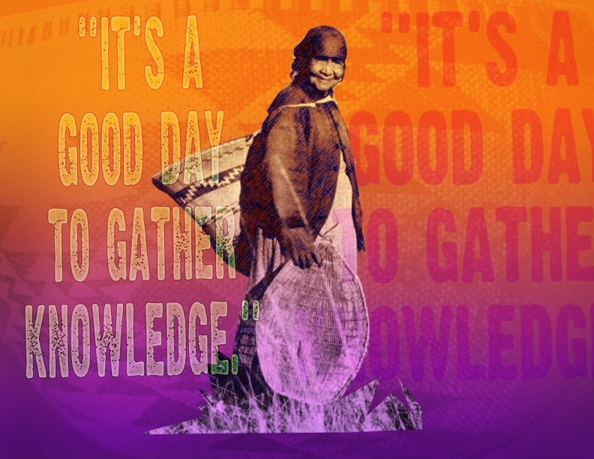
What are the next steps?

Slide 13
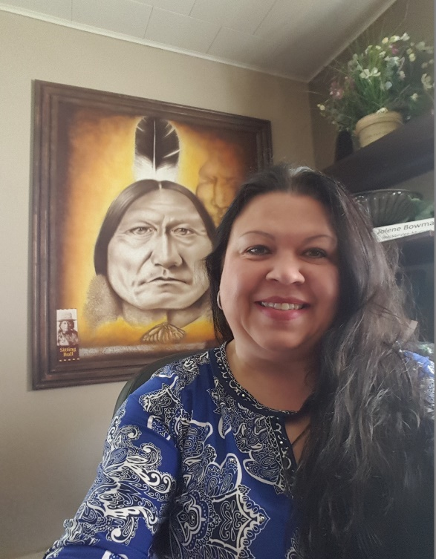

Thank You!
Jolene Bowman, Ph.D.
Director of Education and Career Services
Jolene.Bowman@Mohican-nsn.gov
Direct: 715-793-4060
Cell: 715-851-3734

